Slide 1
حل تمرین مدار منطقی

Slide 2
1.
مروری بر درس

Slide 3

Setup Time, Hold Time and Propagation Delay
Setup time:
D input must be stable for a certain amount of time BEFORE the active edge of clock
Hold time:
D input must be stable for a certain amount of time AFTER the active edge of the clock
Propagation Delay (Clock-to-Output):
From the time the clock changes to the time the output changes
Propagation Delay (Data-to-Output):
From the time the data changes to the time the output changes
Mainly defined for latches

Slide 4
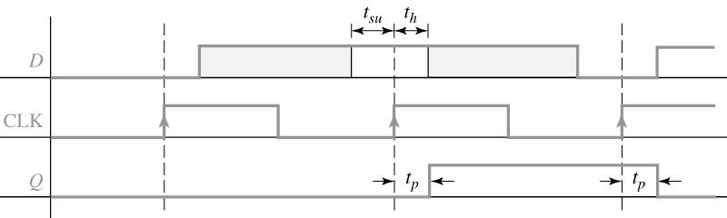

Setup & Hold Time and Propagation Delay
Setup and hold times for a rising edge-triggered D flip-flop
t_{pLH} may be different than t_{pHL}
t_{p} clock-to-output vs. t_{p} D-to-output

Slide 5
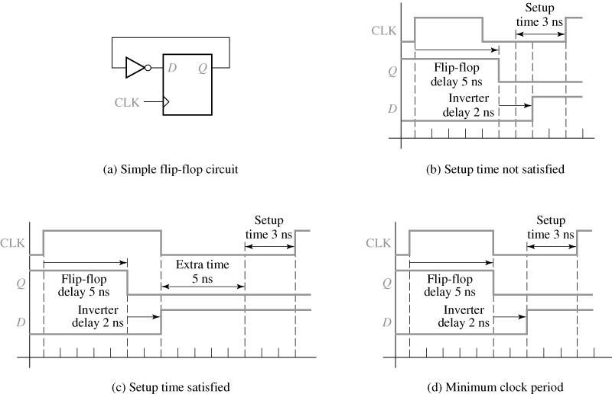

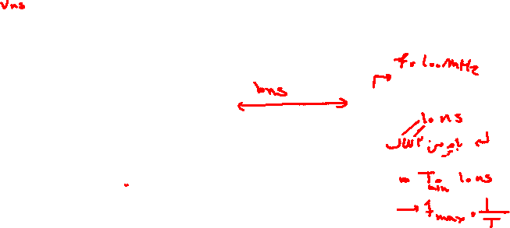
Timing Requirements
Determination of minimum clock period
Assume:
t_{co}= 5 ns
t_{p,inv} = 2 ns
t_{su}= 3 ns

Slide 6
2.
نمونه سوالات

Slide 7
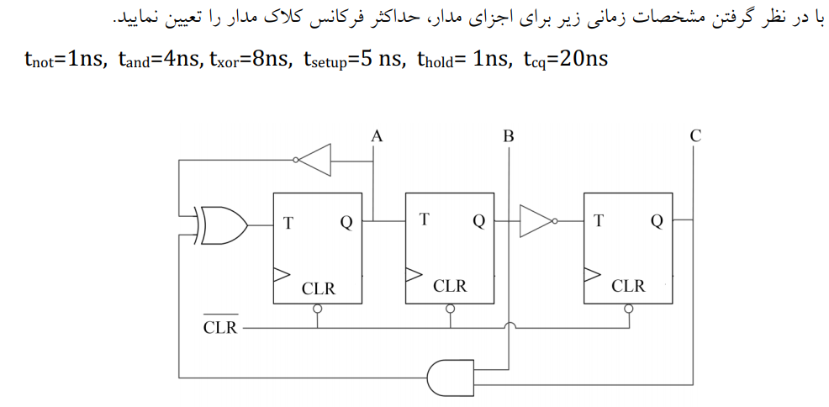
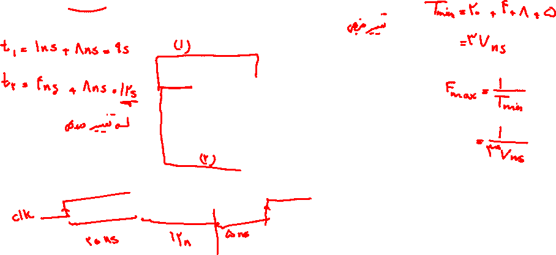

Slide 8
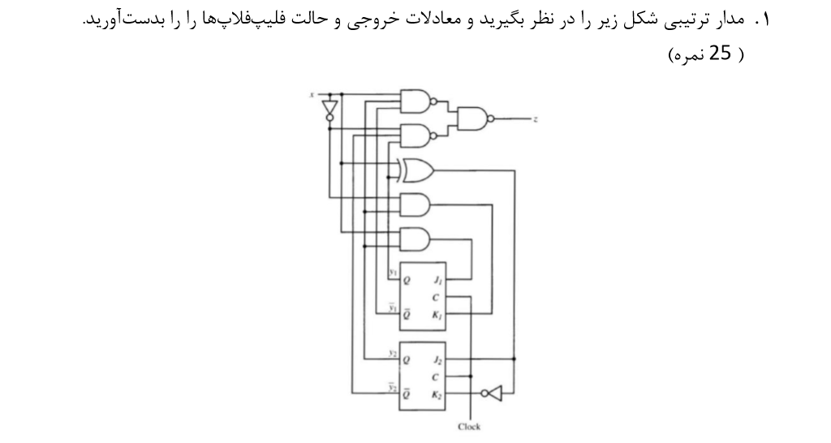
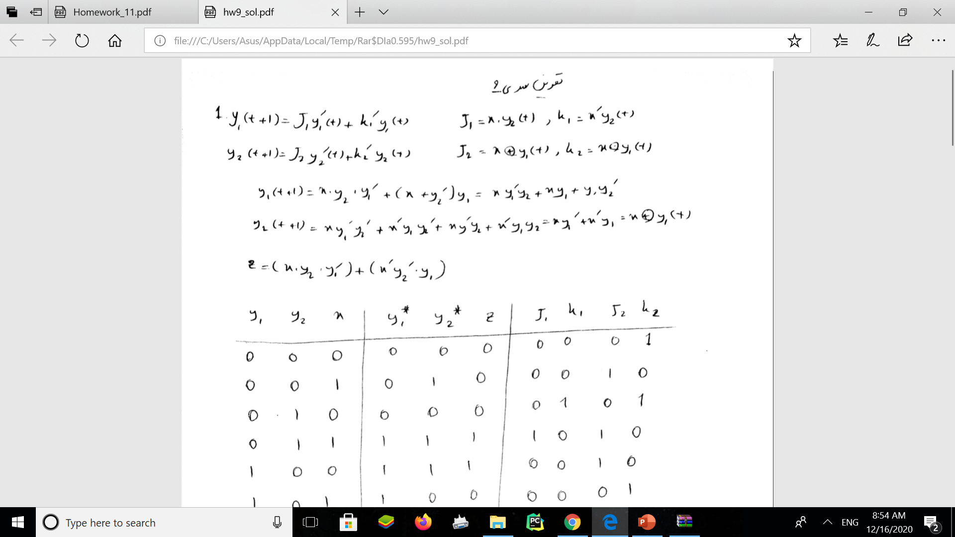

Slide 9
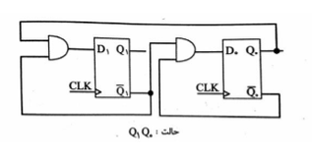
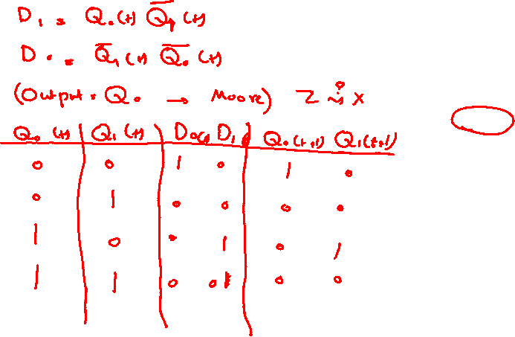

Slide 10
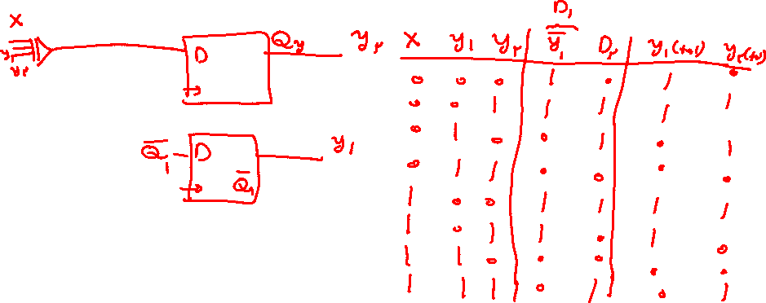
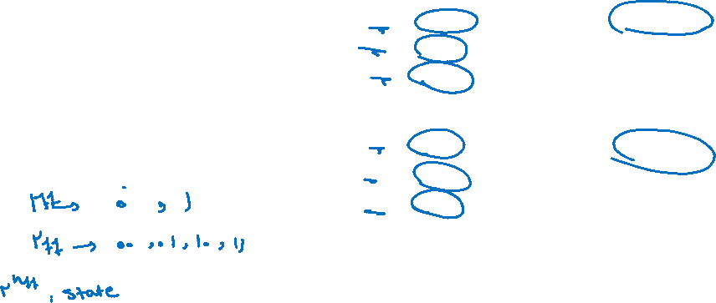

Slide 11
